Slide 1
React-ing to Hotwire
David Hill / RailsConf 2022
Notes:
Hi, welcome to React-ing to Hotwire. I’m primarily going to be telling the story of why I ended up migrating an application from React to Hotwire, back in 2021. Most of what I’m going to mention happened at my previous job, but first…

Slide 2

CareRev is a labor marketplace platform that connects hospitals and health systems with local, vetted healthcare professionals on demand.
We’re hiring!
(But we’re not using Hotwire…yet…)
Notes:
I’m currently working as a Staff Backend Engineer at CareRev. I’m going to quote the official company description on the RailsConf sponsors page here: “CareRev is a labor marketplace platform that connects hospitals and health systems with local, vetted healthcare professionals on demand.” The less official description is we’re trying to make it easier for healthcare professionals to find work while also controlling their own schedules. And we’re hiring, so if you’re thinking about making a change, please give CareRev a look.
Word of warning, given the nature of this talk, we’re not using Hotwire…yet…

Slide 3

Let’s talk about
Notes:
Since I’m more or less telling a story here, it’s probably best to start at the beginning. In this case the means talking about React. Since I’m going to be talking about an experience that soured me on React and led to a transition to Hotwire, I wouldn’t blame anyone for thinking that I don’t like React. In fact I do like React. The one professional break I have taken from Rails in my career was a 6-month contract doing React.

Slide 4


There is still good in
Notes:
There is still good in React. I’m just going to be up front and say that I like Hotwire more.

Slide 5
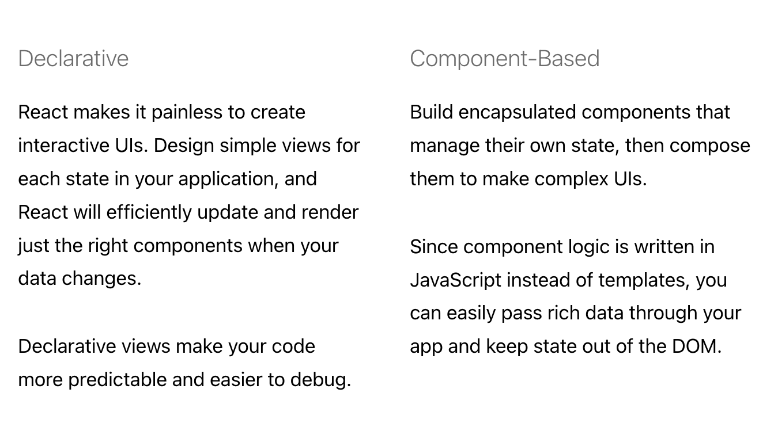
Notes:
Some of the thing I specifically like about React. It’s focus on building interactive UIs, and that it doesn't care about anything else

Slide 6
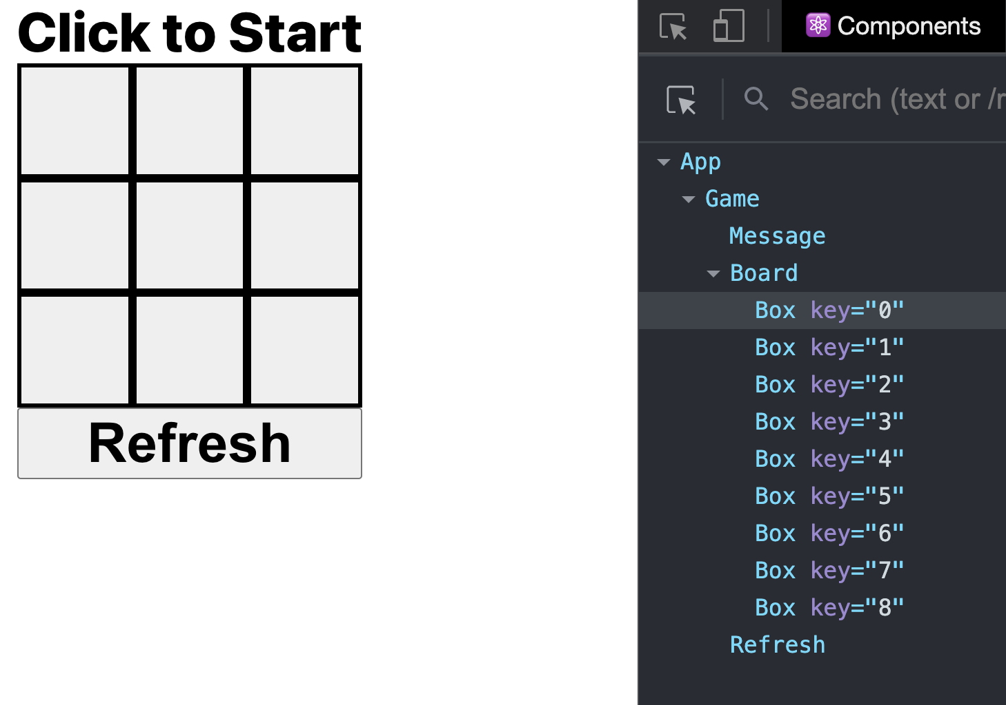
https://github.com/umangshrestha/tic-tac-toe/
Notes:
With the React Developer Tools extension, I can easily see what React components are rendered to the page and how they’re structured in relation to each other. And since I can see the Component names, it’s dead simple to find the code for that component. If I want to change something about the Box Component, I just need to find and open up the Box.js file.

Slide 7

In 2019…
…at a previous job…
_______________________________
______________________________
_______________________

Slide 8




Developers
Projects
Notes:
The team grew to about 5 developers, maintaining 3 active projects. One of the projects was very much in development as an internal tool for the company. Another was an incentive program that hadn’t officially launched yet. And then there’s the flagship application for the company. One of those projects is clearly more important than the other two.
5:3 isn’t the greatest of programmer-to-project ratios, but we were getting by. Until…
…3 developers moved on to other opportunities, including both of our front-end, React-focused, developers. So now we’re down to 2:3…which is awful.

Slide 9
Rails Application
React Application
API
React
Admin site
Create-React-App
Sprinkling of React
Notes:
I inherited maintaining the majority of the work for maintaining the flagship application for the company.

Slide 10
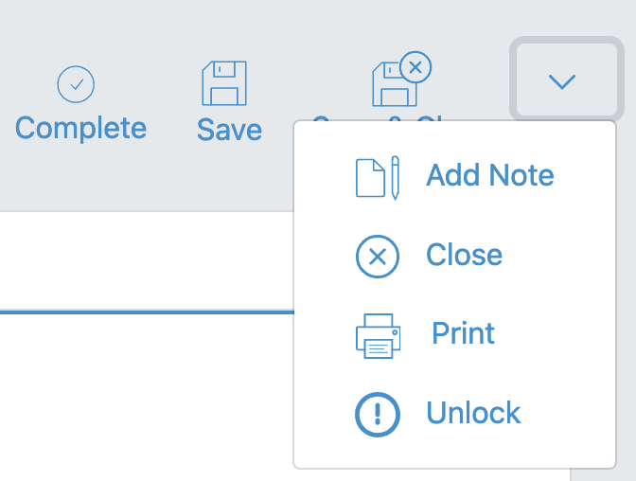
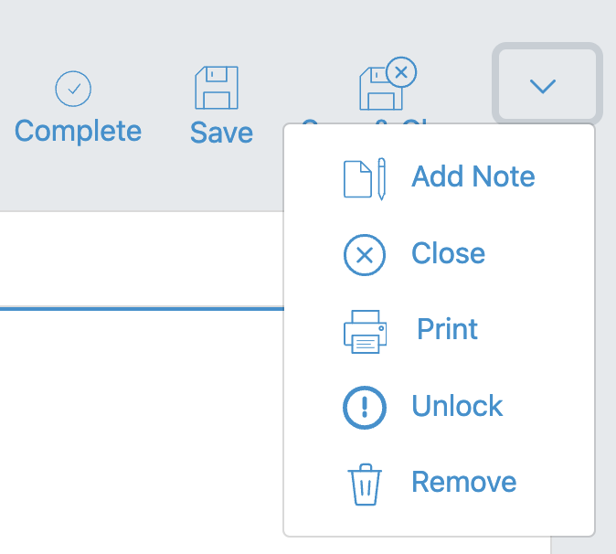
The “simple” change that broke me…

Slide 11
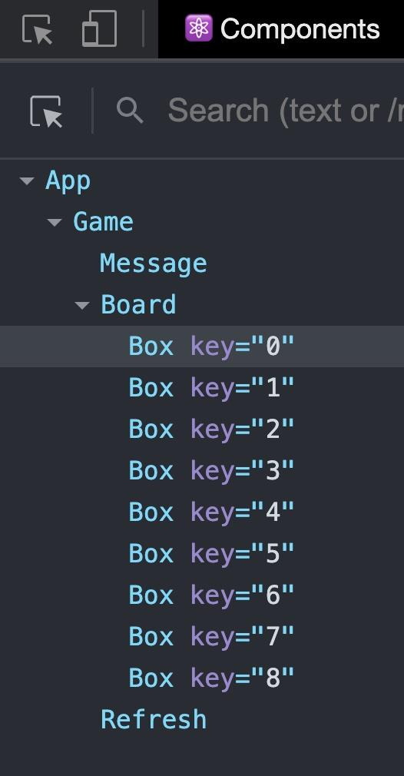
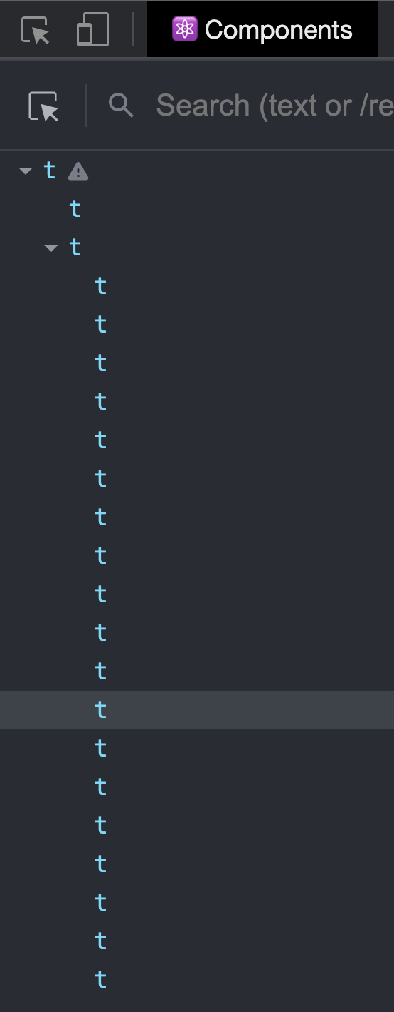
Problem #1: Where is that code…?

Slide 12
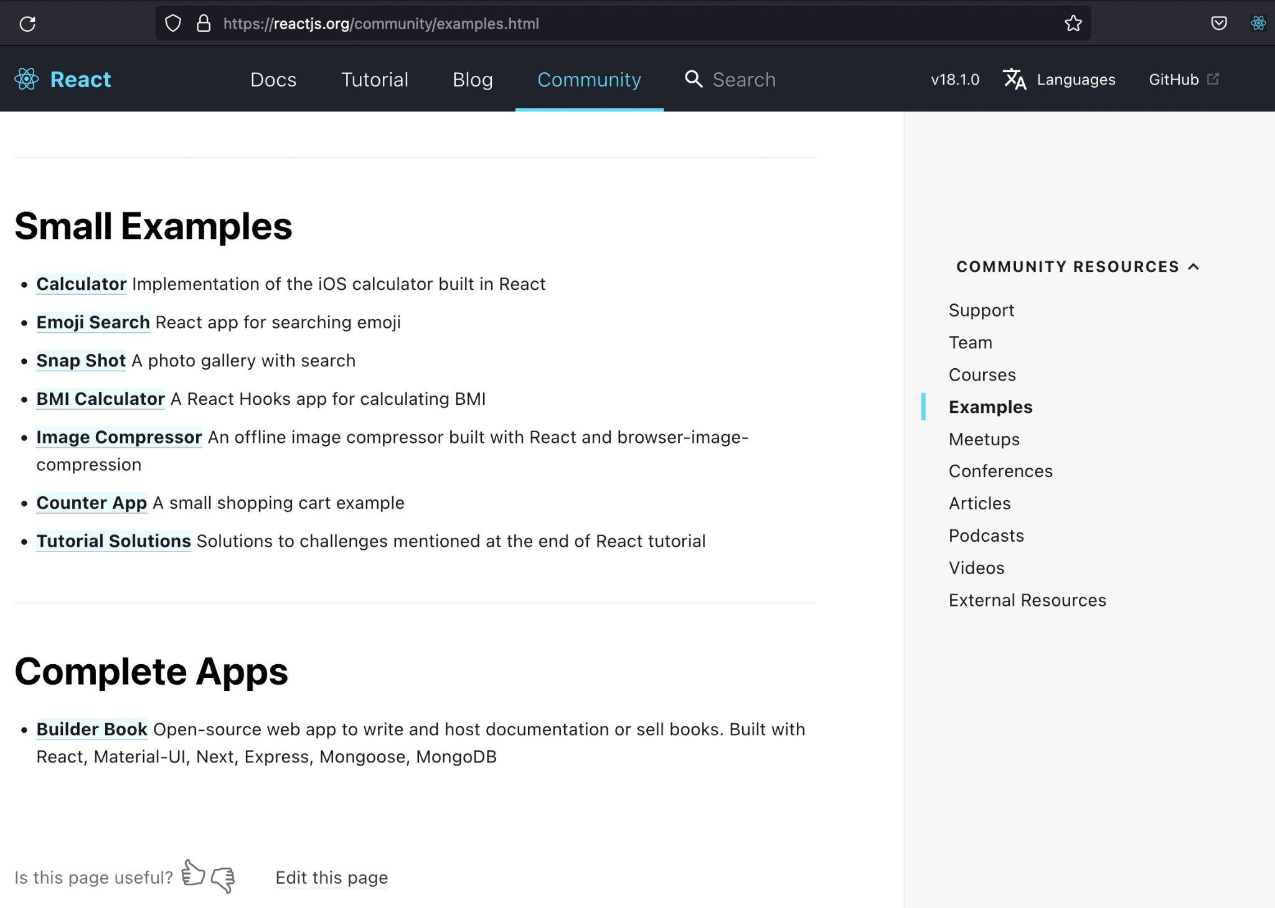
Problem #1: Where is that code…?
Notes:
At first I thought

Slide 13
Problem #2: How Much Code?
Expected Changelog
Actual Changelog
api/config/routes.rb
api/config/routes.rb
api/app/controllers/forms_controller.rb
client/public/locales/en/forms.json
client/src/features/forms/FormContainer.js
client/src/features/forms/FormGenerator.js
client/helpers/formParser.js
client/redux/actions.js
client/redux/closeRemoveDocumentation.js
client/redux/constants.js
client/redux/initialState.js
client/redux/openRemoveDocumentation.js
client/redux/reducer/js
client/redux/requestDeleteRemoveDocumentation.js
client/redux/requestGetRemovalReasons.js
client/schema/RemoveDocumentationSchema.js
api/app/controllers/forms_controller.rb
client/views/shared/menu.html.erb
client/views/forms/show.html.erb

Slide 14


Slide 15


Slide 16
Rails Application
React Application
API
React
Admin site
Create-React-App
Sprinkling of React
Redux
Rekit

Slide 17
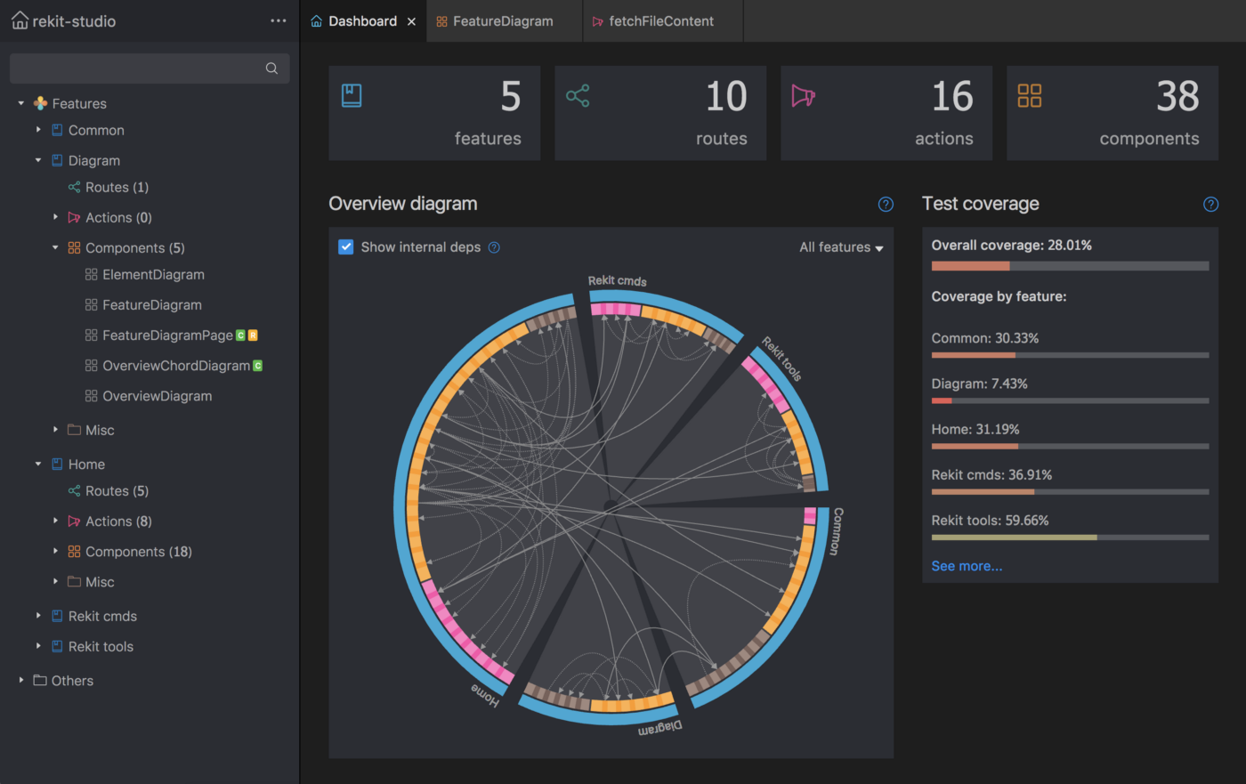

Slide 18


Convincing management to make a change
IS THE WAY

Slide 19

IS THE WAY

Slide 20
Tips for convincing management to make a technology pivot:
Step 1: They have to feel the pain…or as close to it as possible
Step 2: Start with something small, so you can show quick results
Step 3: Almost everything still looks & feels like Rails. Much lower barrier to entry to get things running.
Step 4: Return of the majestic monolith (with Hotwire)!

Slide 21
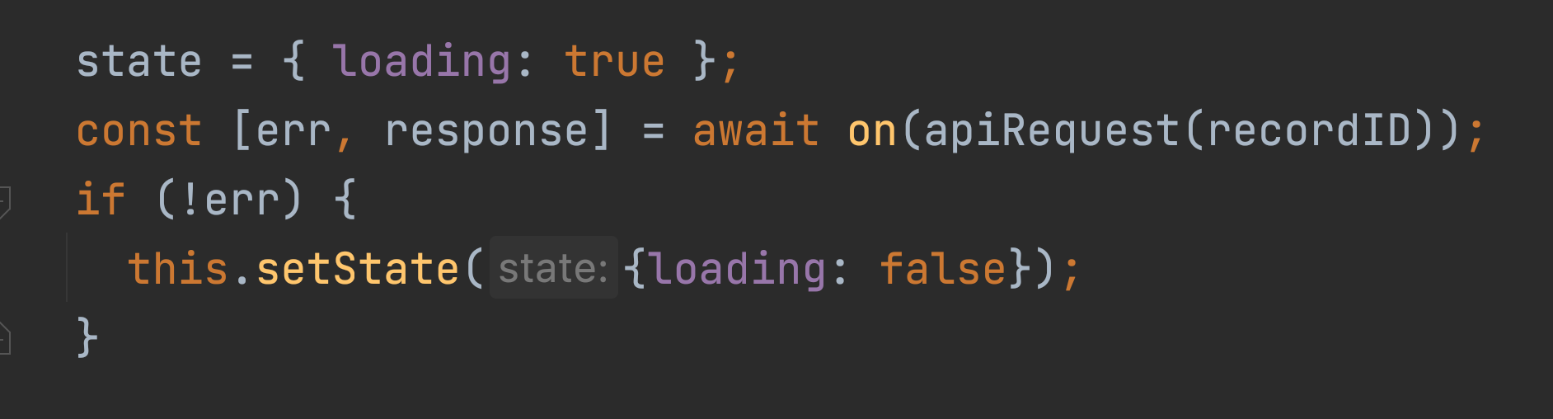
Fun with Hotwire: Turbo Frames
A React way:

Slide 22
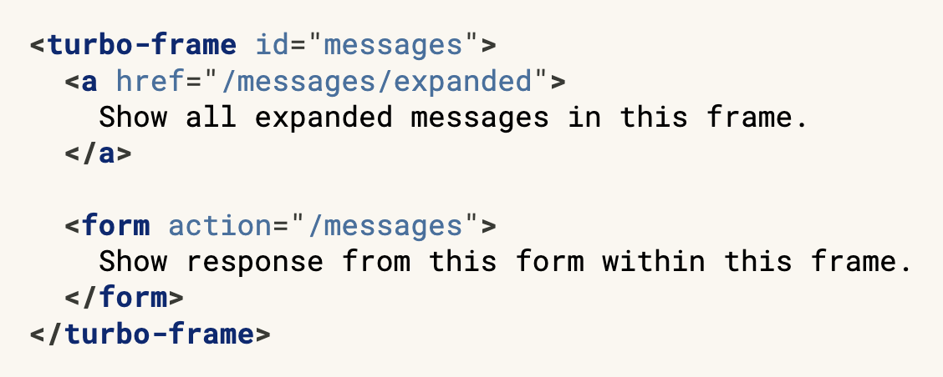
Fun with Hotwire: Turbo Frames
A Hotwire way:

Slide 23
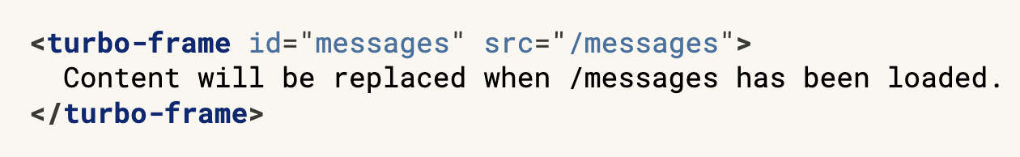
Fun with Hotwire: Turbo Frames
A Hotwire way:

Slide 24
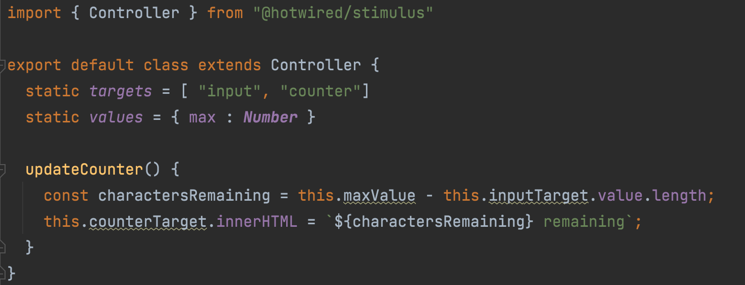
Fun with Hotwire: Stimulus

Slide 25
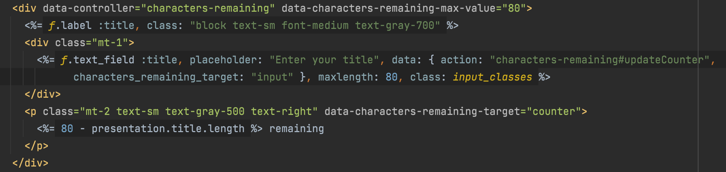
Fun with Hotwire: Stimulus

Slide 26
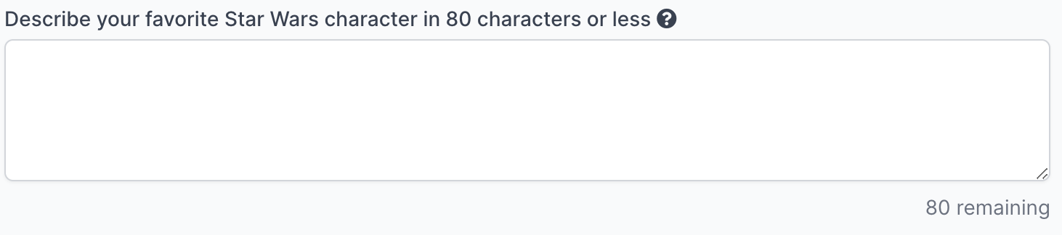
Fun with Hotwire: Stimulus

Slide 27
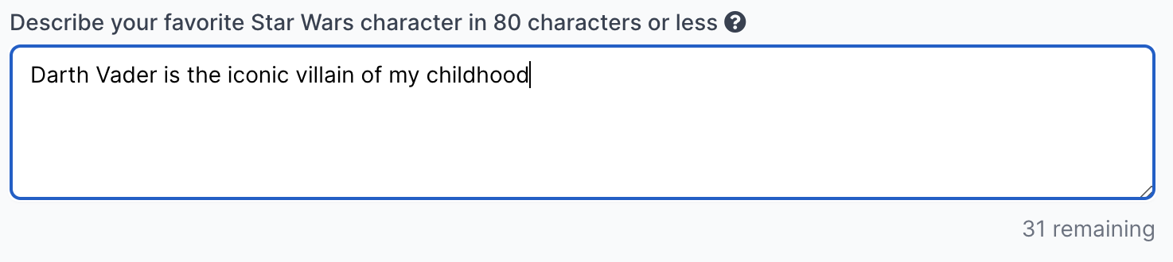
Fun with Hotwire: Stimulus

Slide 28
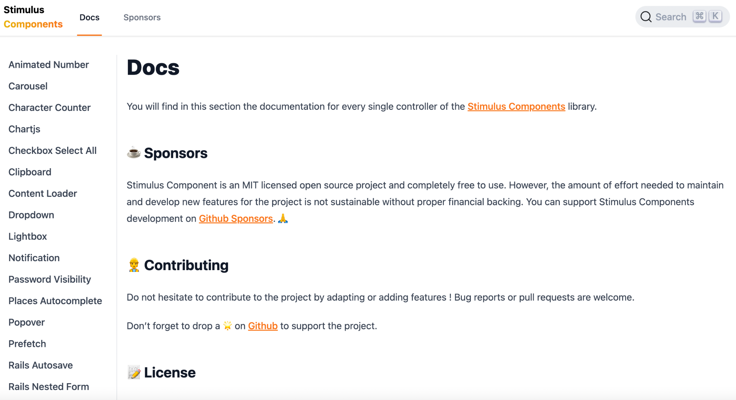
Fun with Hotwire: Stimulus
https://www.stimulus-components.com

Slide 29
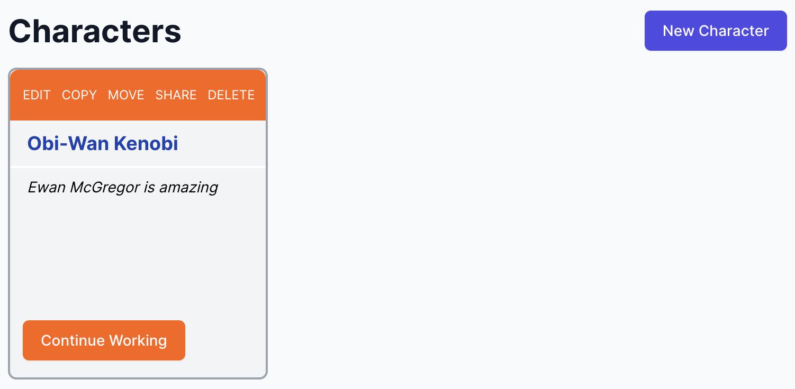
Fun with Hotwire: Turbo Frames + Turbo Streams

Slide 30
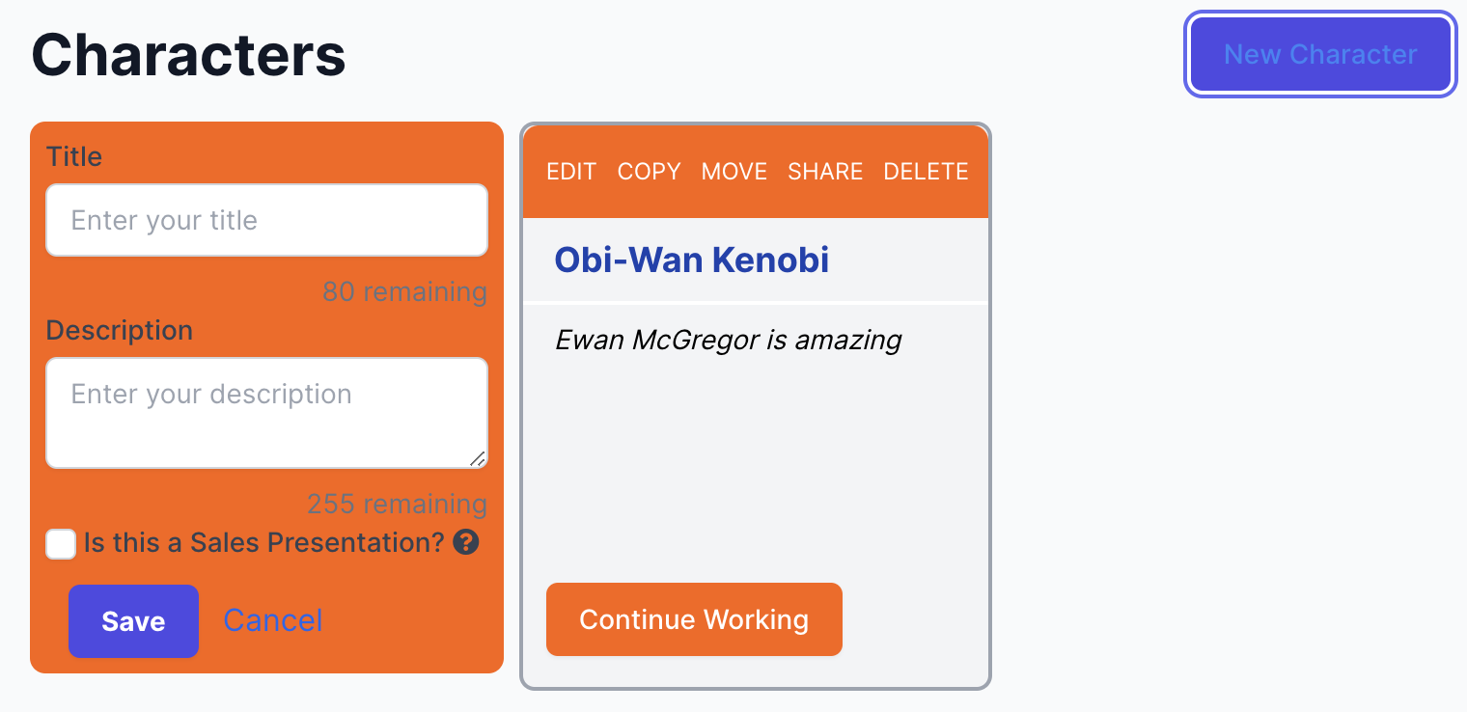
Fun with Hotwire: Turbo Frames + Turbo Streams

Slide 31
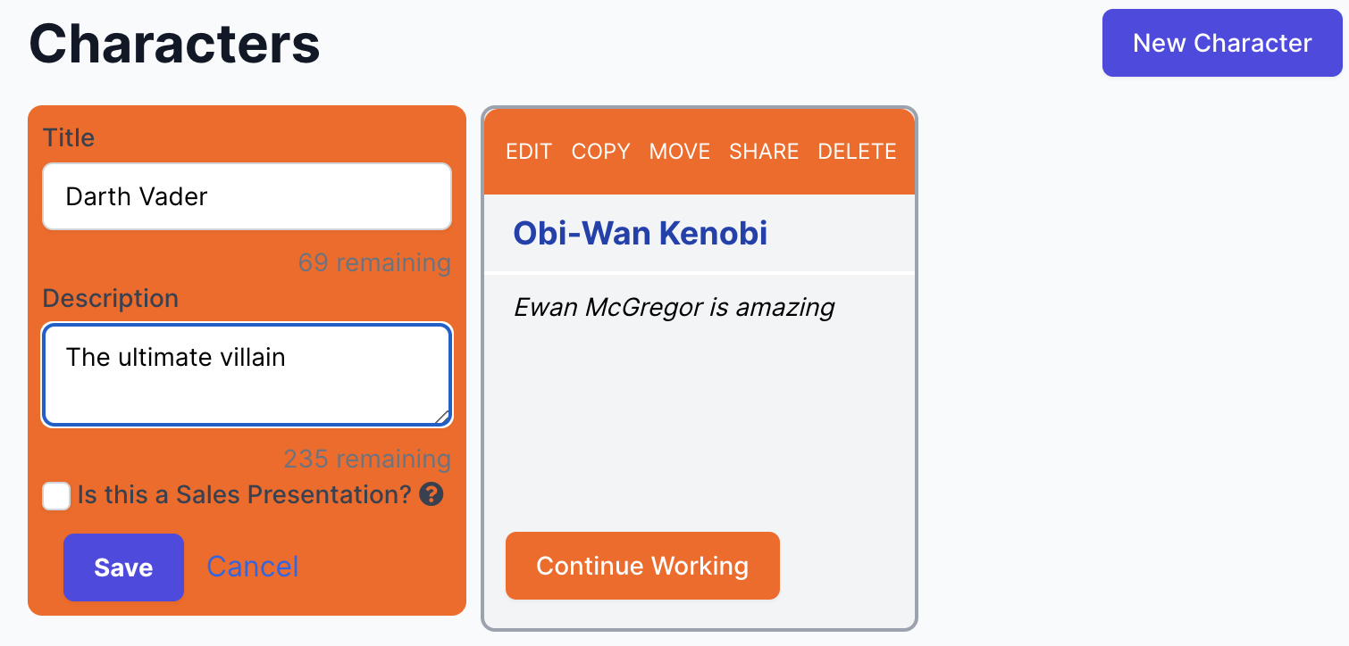
Fun with Hotwire: Turbo Frames + Turbo Streams

Slide 32
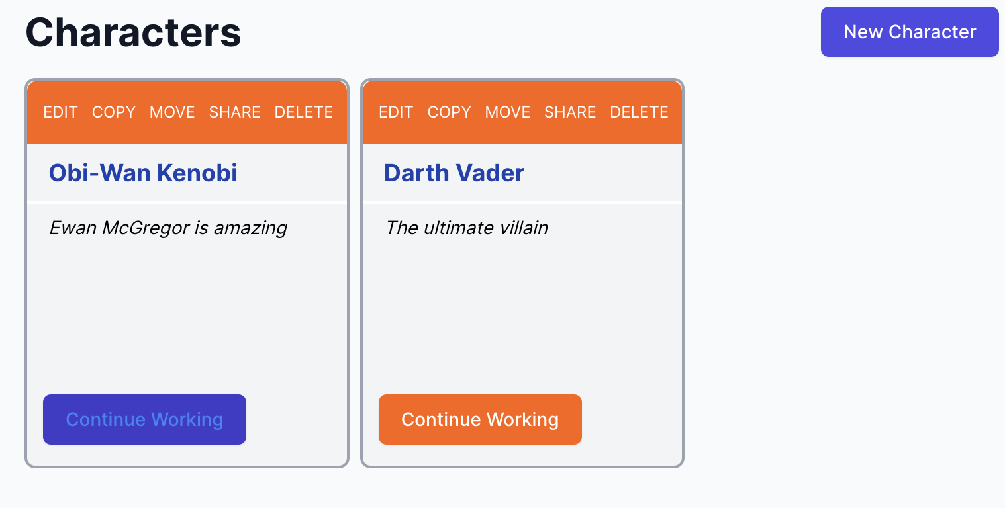
Fun with Hotwire: Turbo Frames + Turbo Streams

Slide 33
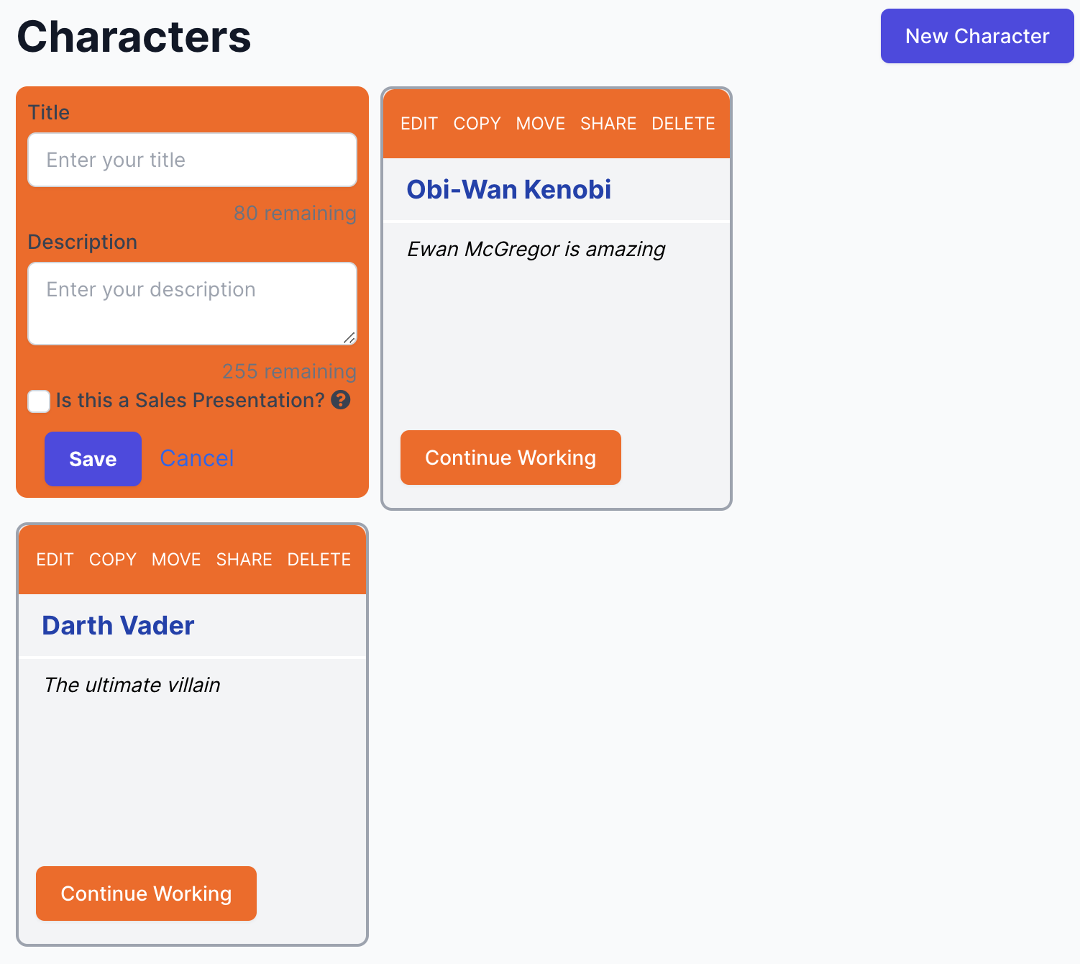
Fun with Hotwire: Turbo Frames + Turbo Streams

Slide 34
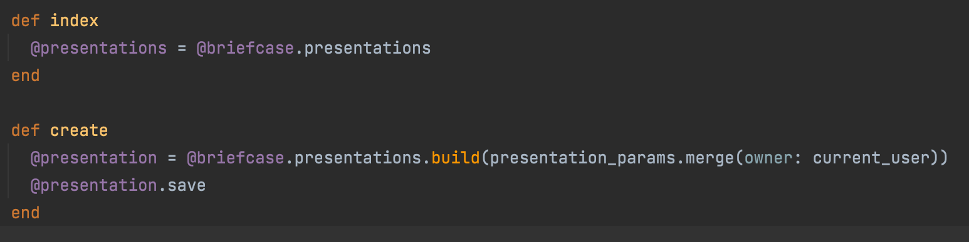
Fun with Hotwire: Turbo Frames + Turbo Streams

Slide 35
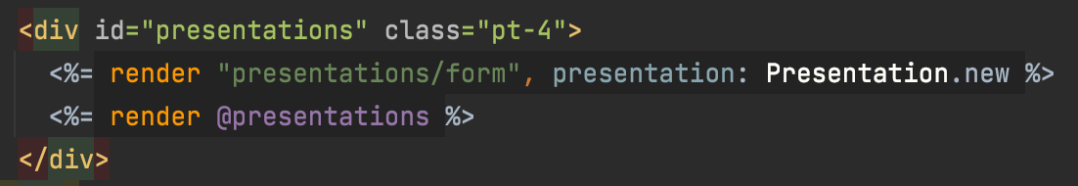
Fun with Hotwire: Turbo Frames + Turbo Streams

Slide 36
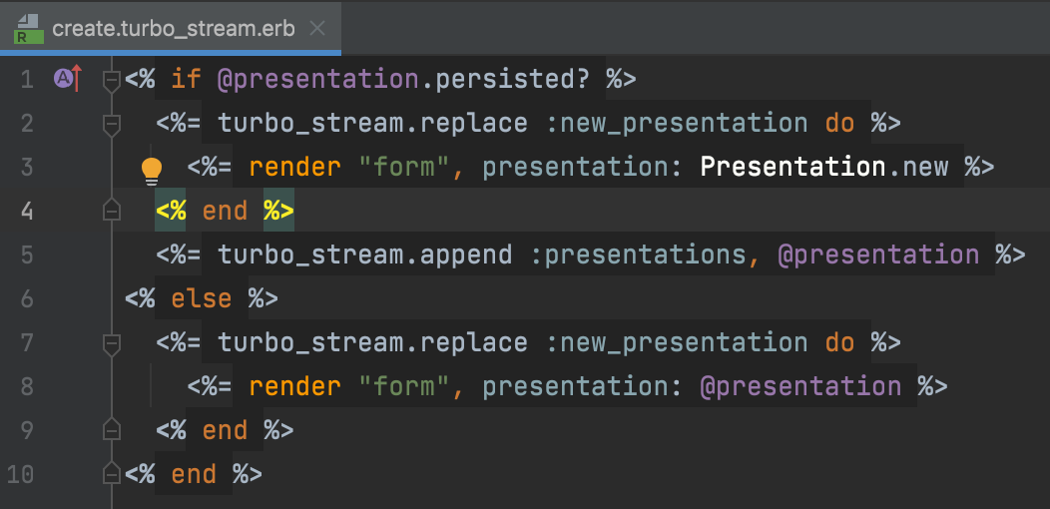
Fun with Hotwire: Turbo Frames + Turbo Streams

Slide 37
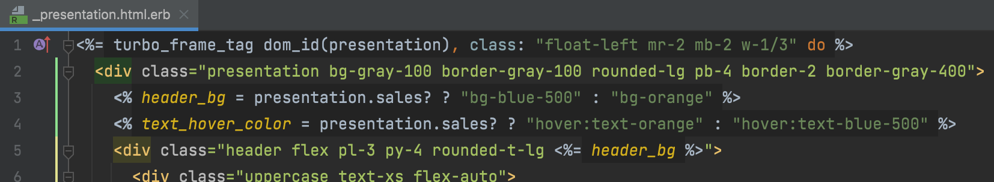
Fun with Hotwire: Turbo Frames + Turbo Streams

Slide 38
Lessons Learned
Client-side state management is huge developer overhead
Hotwire is, I think, especially well suited for individuals and smaller teams. SIGNIFICANTLY reduces the skillset required to deploy complex, interactive apps.

Slide 39

How does the story end?

Slide 40

I mostly tweet about my family, board games, and books. You’ve been warned.
@DavidEsmale

